Slide 1
Team- Atamnirbhar
TOXIC COMMENT CLASSIFICATION CHALLENGE

Slide 2
Problem Statement
We were asked to build a model that’s capable of detecting different type of toxic comments like threats, obscenity, insults and identity-based hate. Dataset was given of comments from wikipedia talk page edits. Corpus had 1 lakh 59 thousand comments from discussions related to user pages and articles. Comments are tagged in following categories:
Toxic
Severe_toxic
Obscene
Threat
Insult
identity_hate

Slide 3
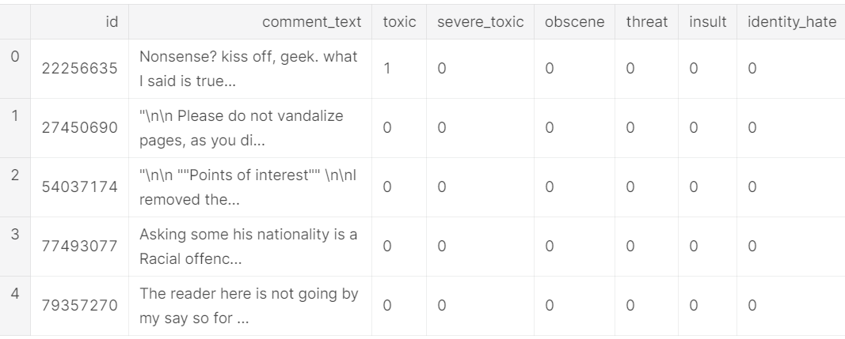
Overview of how data looks

Slide 4
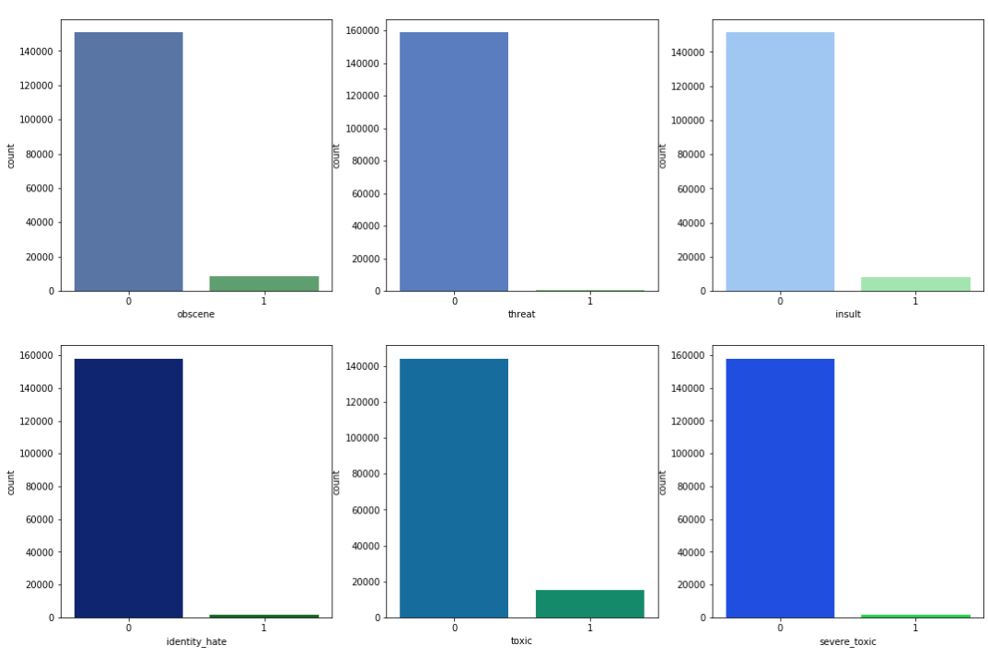
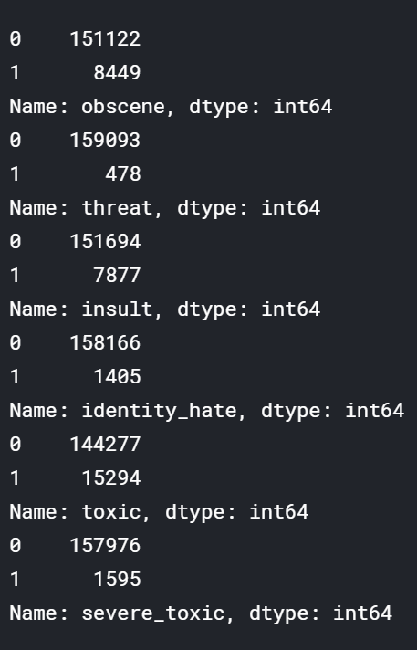
VISUALIZING DATA

Slide 5
APPROACH TO SOLVE PROBLEM STATEMENT
1
BINARY CLASSIFICATION :
Under binary classification to balance the data SMOTE and SVM-SMOTE techniques were used.
For vectorization WORD2VEC was used
Models applied: SVM, LOGISTIC REGRESSION, RANDOM FOREST and MULTINOMIAL NB
2
UNBALANCED CLASSIFICATION:
Ngrams +Logistic Regression DOC2VEC +NB +Logistic regression

Slide 6
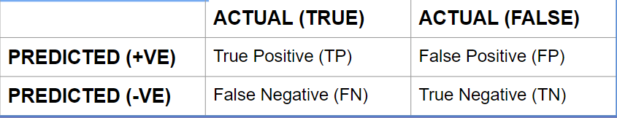
Basic Terminology
CONFUSION MATRIX : It is a table that is often used to describe the performance of a classification model on a set of test data for which the true values are known. It is a table of 4 different combinations of predicted and actual values i.e. a square matrix formed by m*n as follow:
TRUE POSITIVE : It means that model predicted positive and actually it is True.
TRUE NEGATIVE: It means that model predicted negative and actually it is False.
FALSE POSITIVE: It means that model predicted positive and actually it is False.
FALSE NEGATIVE: It means that model predicted negative and actually is it True.

Slide 7
RECALL: It means that out of all the positive classes, how much we predicted correctly. It should be as high as possible. It is calculated as follow:
Recall= TP/ TP+FN
PRECISION: It means out of all positive classes we have predicted correctly, how much are actually positive. The formula used to calculate precision is:
Precision= TP/ TP+FP
ACCURACY: It means that out of all classes, how much we predicted correctly. It is calculated as:
Accuracy= TP+TN/ Total
F-measure:It is difficult to compare two models with high precision & low recall or vice versa. So F score is used which is the harmonic mean of recall & precision by punishing the extreme values.
F-measure= 2*( Recall*Precision/ Recall+Precision)

Slide 8
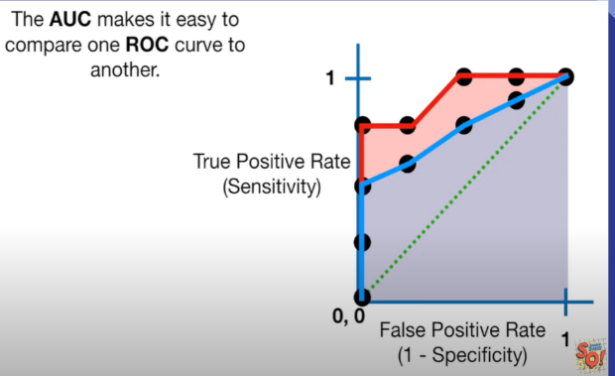
ROC ( Receiver Operator Characteristic) graph summarizes the performance of classifier over all possible thresholds. ROC makes it easy to identify the test threshold for making a decision in other words ROC helps us to determine which threshold is best.
AUC (Area Under the Curve) makes it easy to compare one ROC with other. AUC can help you decide which categorization method is better.
In the figure red and blue lines are ROC and area shaded with respective colors is AUC (area under the curve) for respective curves.

Slide 9
Understanding the techniques

Slide 10
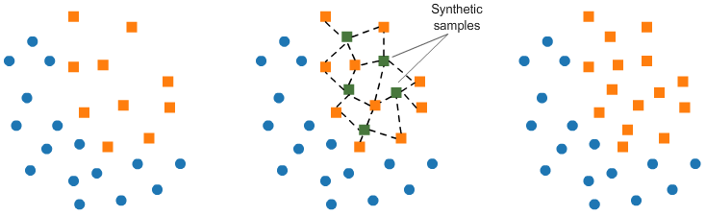
SMOTE
SMOTE (synthetic minority oversampling technique) is one of the most commonly used oversampling methods to solve the imbalance problem.
It aims to balance class distribution by randomly increasing minority class examples by replicating them.
SMOTE synthesises new minority instances between existing minority instances. It generates the virtual training records by linear interpolation for the minority class. These synthetic training records are generated by randomly selecting one or more of the k-nearest neighbors for each example in the minority class. After the oversampling process, the data is reconstructed and several classification models can be applied for the processed data.

Slide 11
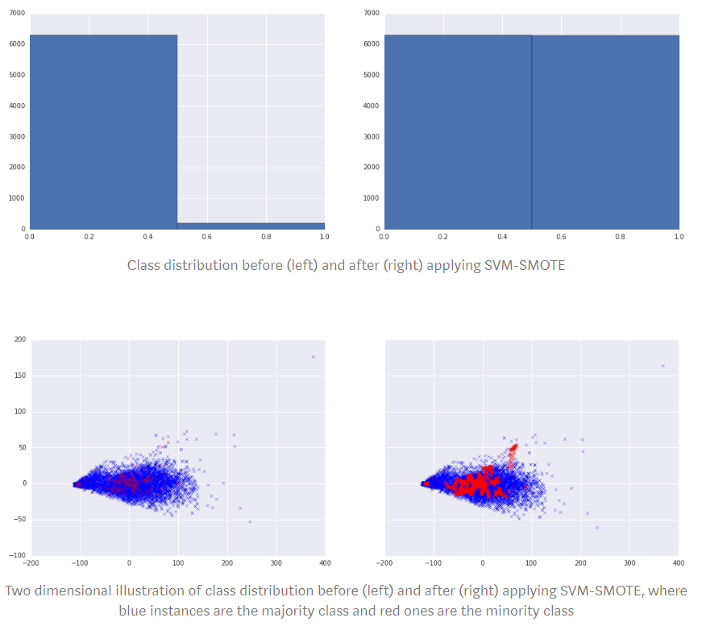
SVM SMOTE
SVM-SMOTE, an over-sampling technique, is used to investigate how well it handles the trade-off. SMOTE, its ancestor, is a popular over-sampling technique which balances class distribution by synthetically generating new minority class instances along directions from existing minority class instances towards their nearest neighbours. SVM-SMOTE focuses on generating new minority class instances near borderlines with SVM so as to help establish boundary between classes.

Slide 12
APPROACH TO SOLVE PROBLEM STATEMENT
1
BINARY CLASSIFICATION :
Under binary classification to balance the data SMOTE and SVM-SMOTE techniques were used.
For vectorization WORD2VEC was used
Models applied: SVM, LOGISTIC REGRESSION, RANDOM FOREST and MULTINOMIAL NB
2
UNBALANCED CLASSIFICATION:
Ngrams +Logistic Regression DOC2VEC +NB +Logistic regression

Slide 13
Different techniques to represent words as vectors
TF/IDF
Hashing Vectorizer
Word2Vec
Doc2Vec
Fasttext

Slide 14
Results
Sr no. | Algorithms | Cross validation score (5 folds) | Accuracy | Confidence interval(95%)
1 | Logistic Regression(TF/IDF) | 0.93160139 | 90.8137 | (90.80-90.81)
2 | Support Vector Classifier(TF/IDF) | 0.99590705 | 96.3279 | (95.92-96.72)
3 | Random Forest(TF/IDF) | 0.99643856 | 96.2669 | (95.86-96.66)
4 | Multinomial NB(TF/IDF) | 0.94766502 | 89.3376 | (88.67-89.99)

Slide 15
Hashing Vectorizer
Advantage -
Hash Vectorizer: This one is designed to be as memory efficient as possible. Instead of storing the tokens as strings, the vectorizer applies the hashing trick to encode them as numerical indexes.
Disadvantage -
The downside of this method is that once vectorized, the features' names can no longer be retrieved.

Slide 16
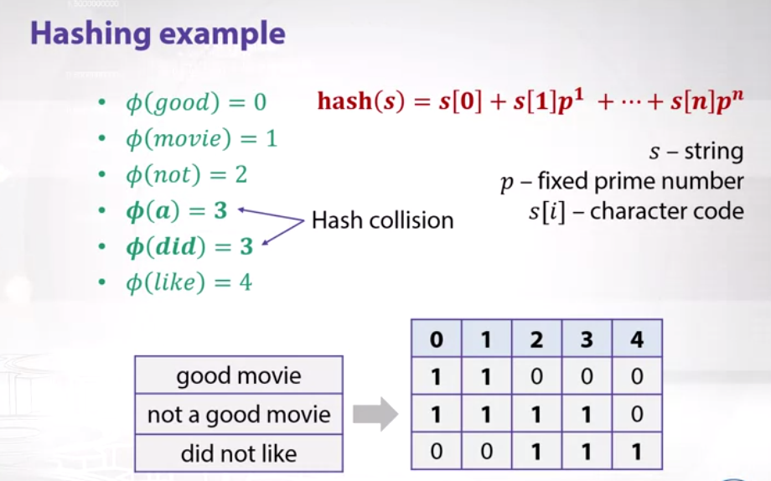

Slide 17
Results
Sr no. | Algorithms | Cross validation score (5 folds) | Accuracy | Confidence interval(95%)
1 | Logistic Regression(Hashing Vectorizer) | 0.87757746 | 90.6307 | [90.62-90.63]
2 | Support Vector Classifier(Hashing Vectorizer) | 0.97908644 | 95.3154 | [95.31-95.32]

Slide 18
What is word2vec?
A two layer neural network to generate word embeddings given a text corpus.
The word2vec objective function causes the words that occur in similar context have similar embeddings
Architecture:
CBOW: Predict the target word from the context.
Skip Gram: Predict the context words from target.

Slide 19
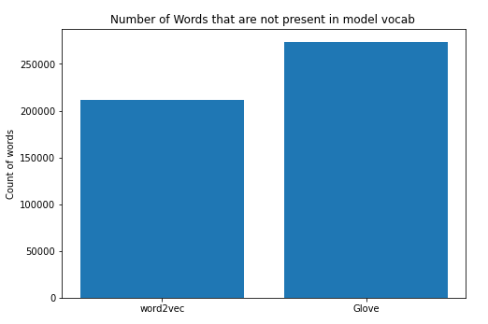
Stats for Pretrained model
Vocabulary length: 337296

Slide 20
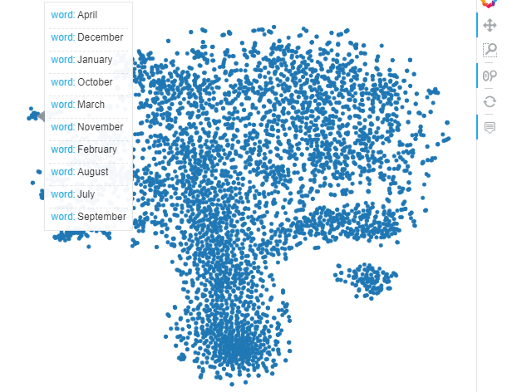
TSNE Scatter plot for word2vec (trained on our corpus):

Slide 21
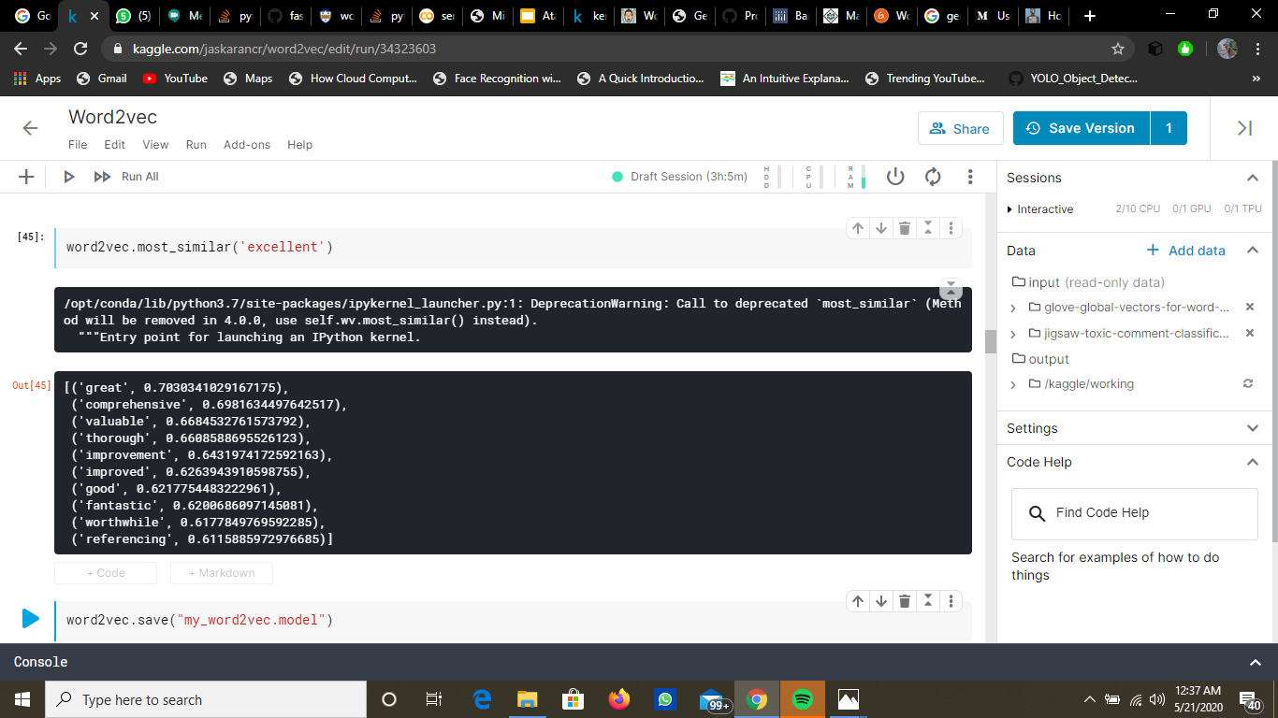

Similar words:
Non-Toxic Toxic
.

Slide 22
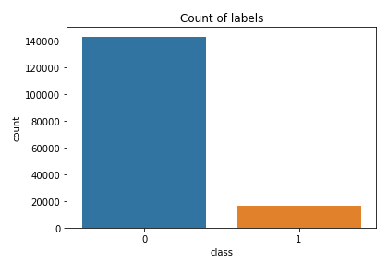
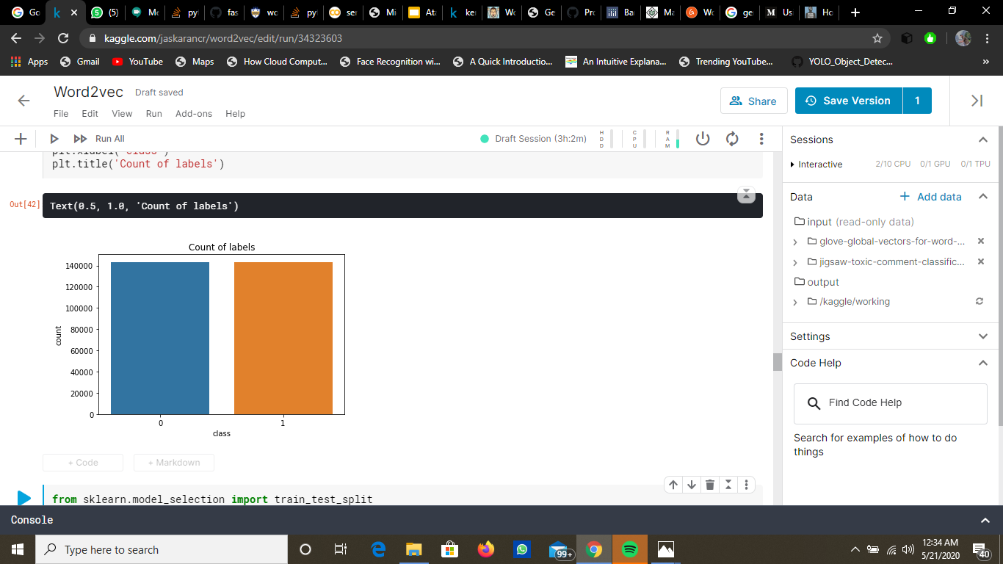
Oversampling:
Before After

Slide 23
Results:
Sr No | Model | Accuracy | Confidence Interval(95%)
1 | word2vec+Naive Bayes | 0.7969(cv=5) | [0.7929 0.8008]
2 | word2vec+Logistic | 0.8751(cv=5) | [0.8719 0.8784]

Slide 24

Downsampling
Before After

Slide 25
Results (Downsampling):
.
Model | Accuracy | Confidence Interval(95%)
Naive Bayes | 0.8156(cv=5) | [0.8043 0.8268]
Logistic | 0.8854(cv=5) | [0.8762 0.8947]

Slide 26
FASTTEXT EMBEDDING (over sampled data)+ Logistic regression
S.No | Algorithm | Accuracy | Confidence int. (95%)
1. | Fasttext +Logistic regression | 87%(cv=5) | [85.57 88.43]

Slide 27
Text Preprocessing before Ngrams
Removed Stopwords.
Removed IP addresses, weird spaces.
Instead of removing Emojis we have used those emojis as our information In form of text data.
Removed irrelevant accents.
Removed Repetitive characters. Ex =heyyy this long ------> hey this long

Slide 28
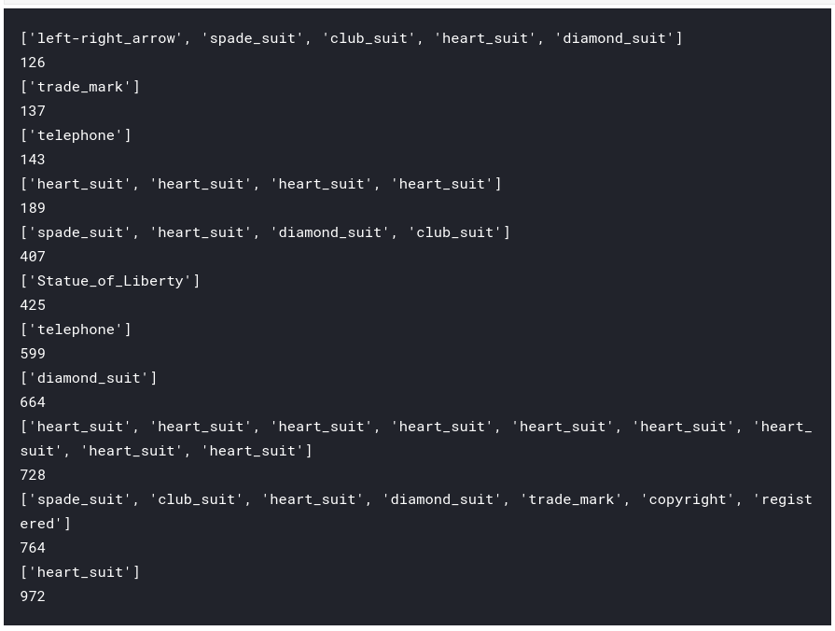
EMOJI’S Preprocessing

Slide 29
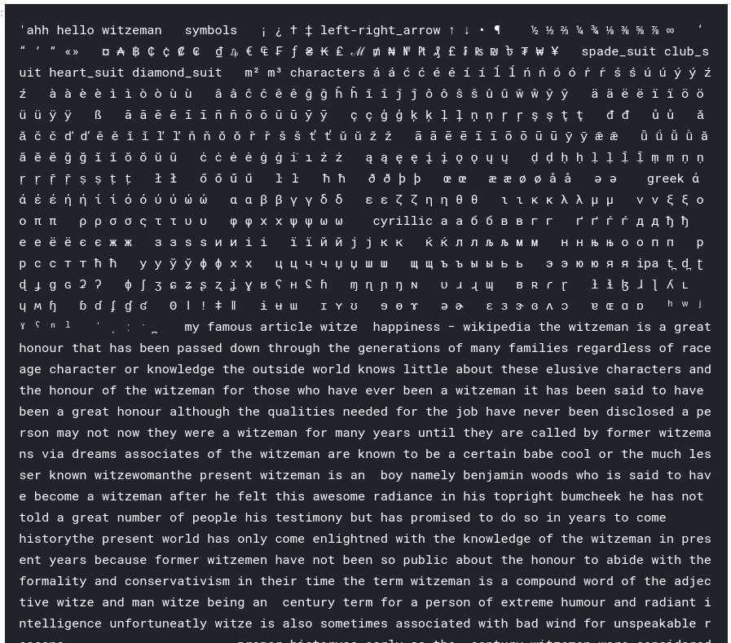
Before Removing German and French accents

Slide 30
N grams (word) + Logistic regression
In this approach instead of using any pretrained embedding we approached with more intuitive way of using because bag of words where we lose information in some sense we have used 3 grams as our feature set and then passed those features through a Logistic regression model. And finally got Cross Validation score of 0.96 on Training data
Our Metrics for Evaluation Was ROC-AUC score

Slide 31
Doc2Vec + NB +Logistic regression
At Last we used Doc2Vec +Naive Bayes and passed those parameters to Our classification model that was Logistic Regression.
And we got MEAN ROC-AUC score of 89.7 on Private Dataset of Kaggle.
We used Naive bayes probabilities and multiplied it to complete feature space of a document created by Doc2vec and passed those features to our classification model .

Slide 32
RESULTS OF UNBALANCED CLASSIFICATION
S. NO | Algorithms | Cross Validation Score
1 | Ngrams+Logistic regression | 0.96(cv=3)
2 | Doc2Vec+NB+Logistic regression | 0.86(cv=3)
BUT ON PRIVATE DATASET on KAGGLE Algorithm 2 performed far well
S.No | Algorithms | MEAN ROC-AUC private data set
1 | Ngrams+Logistic regression | 0.50
2 | Doc2Vec+NB+Logistic regression | 0.89

Slide 33
Feature Engineering
We have thought of creating new features that can be used with other features for this task in future:-
We found these 4 features of some relevance:-
Proportion of capitals
Number of Unique words
Number of Exclamation marks
Number of Punctuation marks

Slide 34
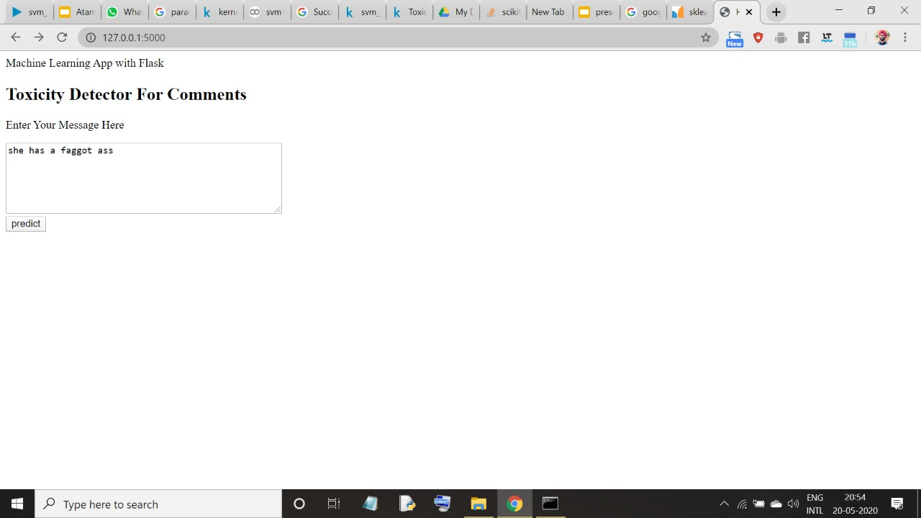
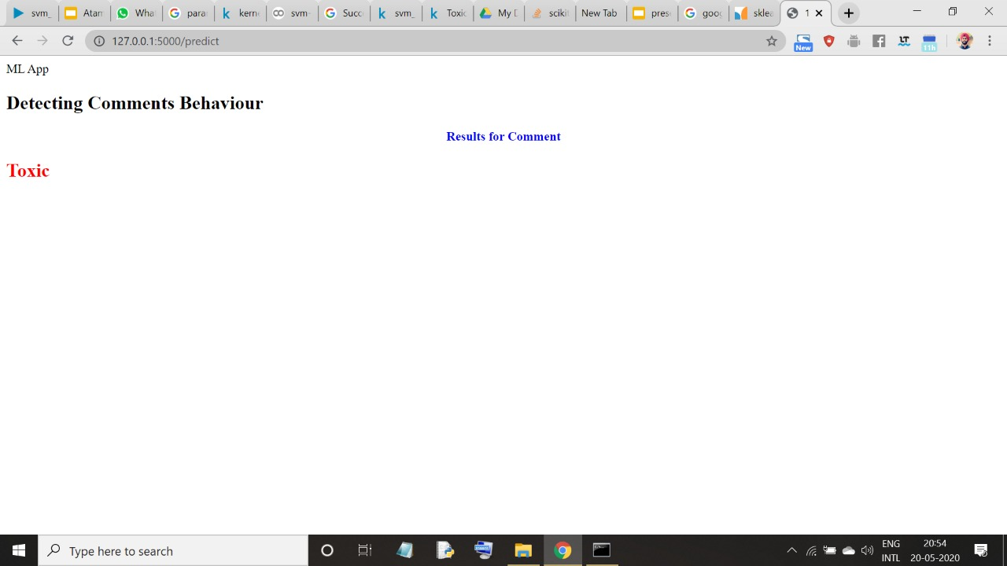
Deployment as a RESTful API

Slide 35
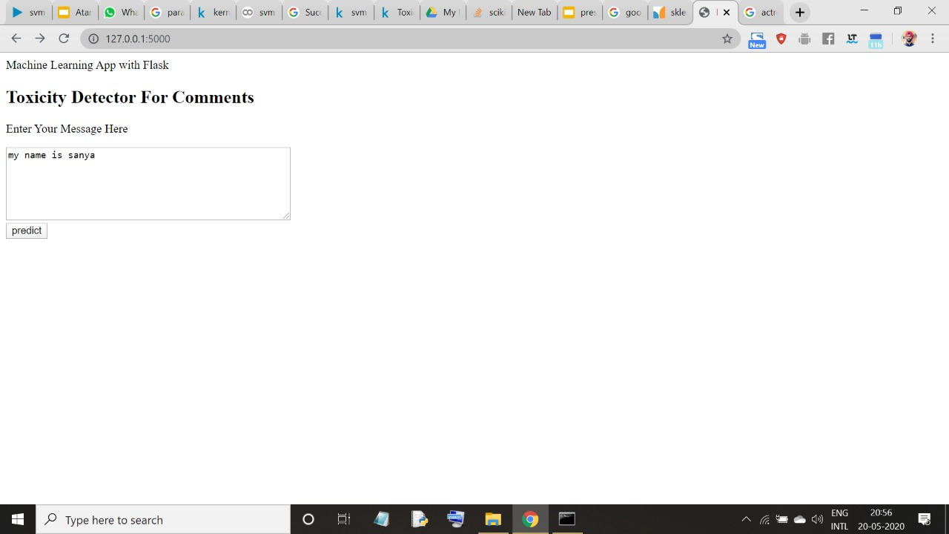

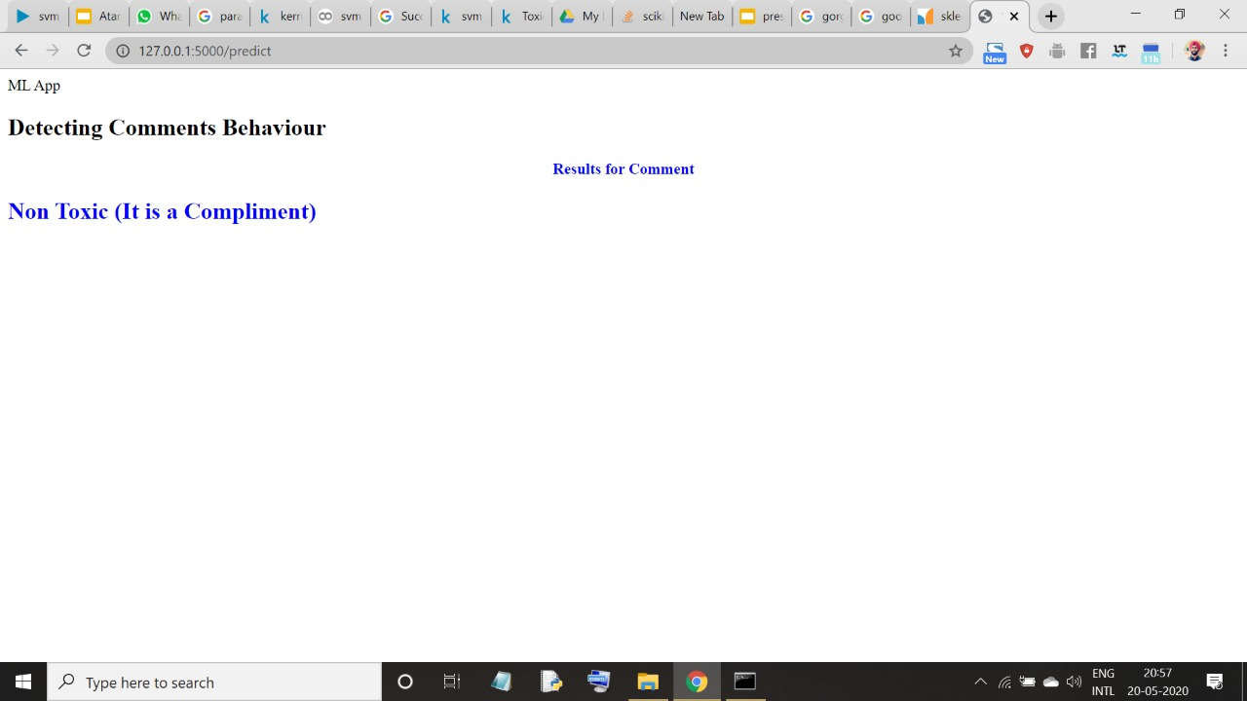

Slide 36
Future scope:-
Instead of using Word2vec,GLOVE we can use Fasttext embeddings because there is no issue of Out of vocabulary words as fasttext is trained on N-grams embeddings.
Fasttext reaks the word into character level grams at lowest level and then combines there embedding to make the word embedding for word that was out of vocabulary.
It is also better Than Levenshtein distance alone to correct the wrong because by levenshtein distance we can only correct the wrong word but that editing does not makes any contribution to our embedding.
Because these Transformer models use attention mechanism to avoid the problem of POLYSEMY.
We can use BERT embeddings that have the concept of positional encoding and wordpiece tokeniser And can use them with any classification ML model.
As this is a classification problem we can also use Variants of BERT specialised for Text classification.

Slide 37
REFERENCES
https://medium.com/wisio/a-gentle-introduction-to-doc2vec-db3e8c0cce5e
https://radimrehurek.com/gensim/models/doc2vec.html
https://marvinlsj.github.io/2018/11/23/NBSVM%20for%20sentiment%20and%20topic%20classification/
https://towardsdatascience.com/multi-class-text-classification-with-doc2vec-logistic-regression-9da9947b43f4
https://www.kaggle.com/tarunpaparaju
https://towardsdatascience.com/introduction-to-word-embedding-and-word2vec-652d0c2060fa
https://www.quora.com/How-does-fastText-output-a-vector-for-a-word-that-is-not-in-the-pre-trained-model
https://www.quora.com/What-is-the-main-difference-between-word2vec-and-fastText

Slide 38
Thank you.

